Slide 1
THE INTERNET OF THINGS
(IoT)
ALVIN VARGHESE
ROLL NO. : 12
CSE-A
DATE : 28/05/2021

Slide 2
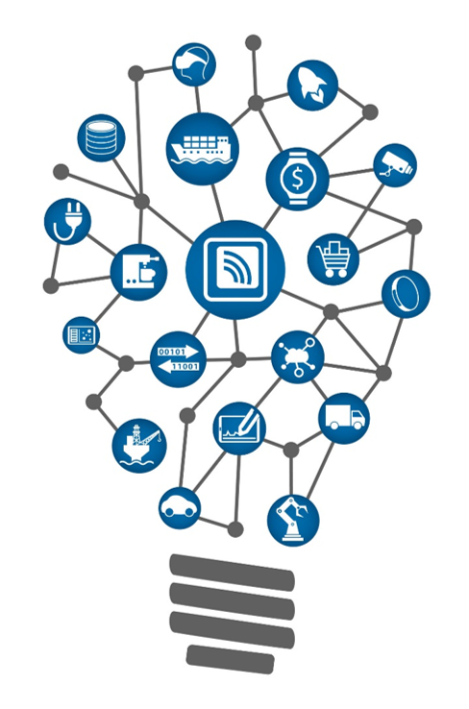
CONTENTS
What is IoT ?
How it works
Components of IoT
Applications of IoT
Challenges of IoT
Advantages of IoT
7. Disadvantages of IoT
8. How big is IoT
9. Why is IoT important
10. How to start as a CS student
11. Reference
12. conclusion

Slide 3
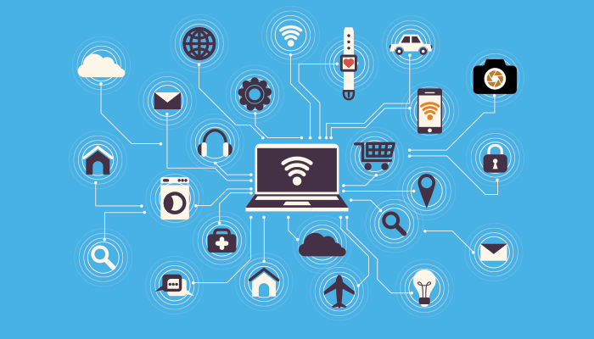
WHAT IS INTERNET OF THINGS ?
The Internet of Things simply means taking all the things in the world and connecting them to the internet !
Internet of Things (IoT) is a network of "things" that are embedded with software, electronics, network, and sensors that allows these objects to collect and exchange data.
The goal of IoT is to extend to internet connectivity from standard devices like computer, mobile, tablet to relatively dumb devices like a toaster.

Slide 4
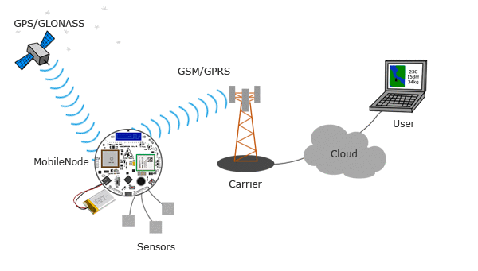
HOW IoT WORKS ?
The entire IoT process starts with the devices themselves like smartphones, smartwatches, electronic appliances like TV, Washing Machine which helps you to communicate with the IoT cloud.
Once the data gets to the cloud, software processes it and then might decide to perform an action, such as sending an alert or automatically adjusting the sensors/devices without the need for the user.
But if the user input is needed or if the user simply wants to check in on the system, a user interface allows them to do so.

Slide 5
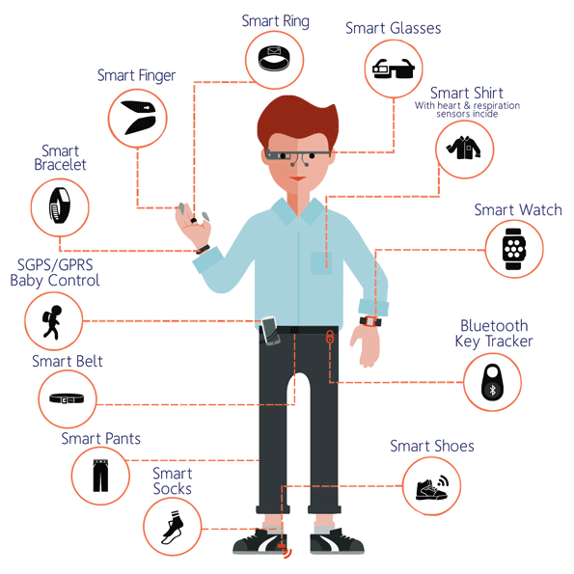
APPLICATIONS OF IoT
The are many applications of IoT here we will discuss some of the applications:
Wearables
Wearable technology is a hallmark of IoT applications and probably is one of the earliest industries to have deployed the IoT at its service. We happen to see Fit Bits, heart rate monitors and smartwatches everywhere these days.

Slide 6
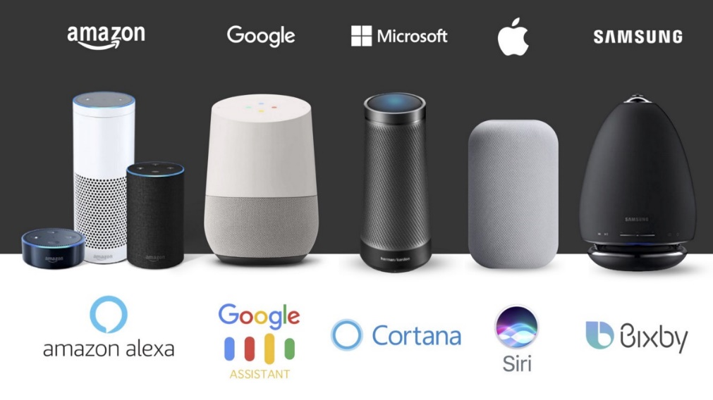
2. Smart Home Applications
When we talk about IoT Applications, Smart Homes are probably the first thing that we think of. The best example I can think of here is Jarvis, the AI home automation employed by Mark Zuckerberg.

Slide 7
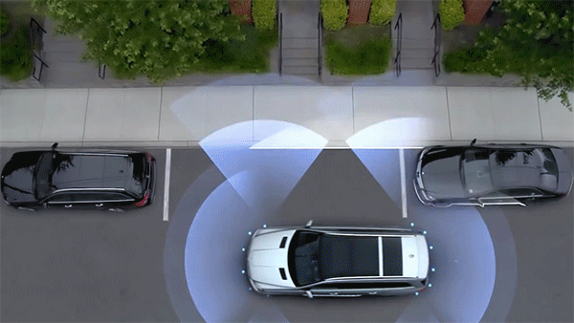
3. Connected Cars
A connected car is a vehicle which is able to optimize it’s own operation, maintenance as well as comfort of passengers using onboard sensors and internet connectivity.
Most large auto makers as well as some brave startups are working on connected car solutions. Major brands like Tesla, BMW, Apple, Google are working on bringing the next revolution in automobiles.

Slide 8
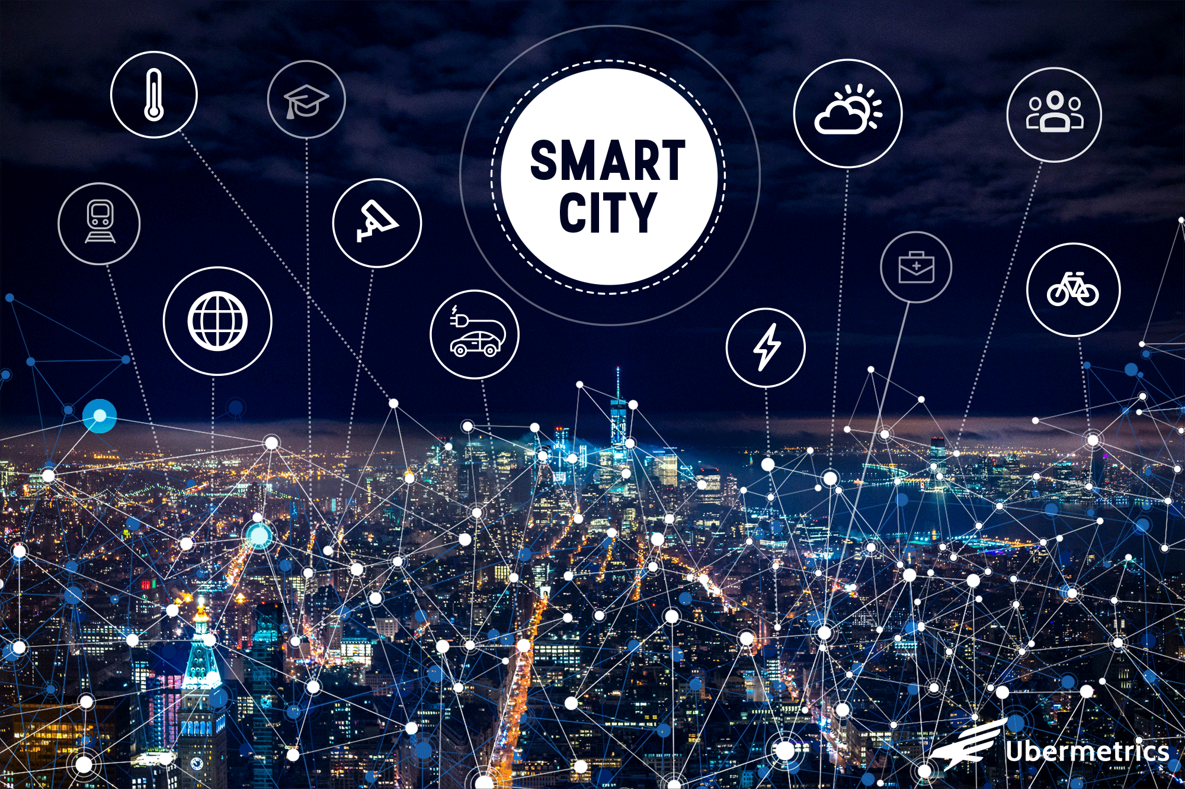
ADVANTAGES OF IoT
Key benefits of IoT technology are as follows:
Technical Optimization: IoT technology helps a lot in improving technologies and making them better
Improved Data Collection: Traditional data collection has its limitations and its design for passive use. IoT facilitates immediate action on data.
Reduced Waste: IoT offers real-time information leading to effective decision making & management of resources.
Improved Customer Engagement: IoT allows you to improve customer experience by detecting problems and improving the process.

Slide 9
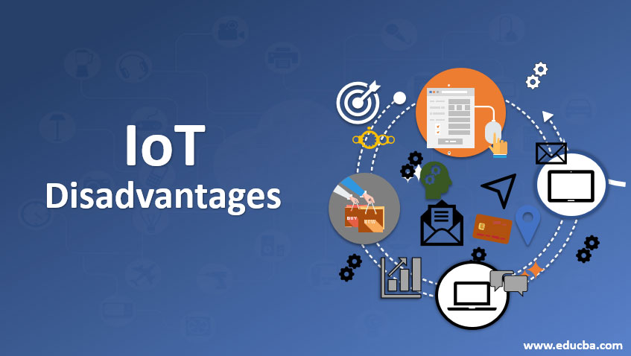
DISADVANTAGES OF IoT
Now, let's see some of the disadvantages of IoT in this Internet of Things tutorial:
Security: IoT technology creates an ecosystem of connected devices. However, during this process, the system may offer little authentication control despite sufficient security measures.
Privacy: The use of IoT, exposes a substantial amount of personal data, in extreme detail, without the user's active participation. This creates lots of privacy issues.
Complexity: The design of the IoT system is also quite complicated. Moreover, it's deployment and maintenance also not very easy.
Compliance: IoT has its own set of rules and regulations. However, because of its complexity, the task of compliance is quite challenging.

Slide 10
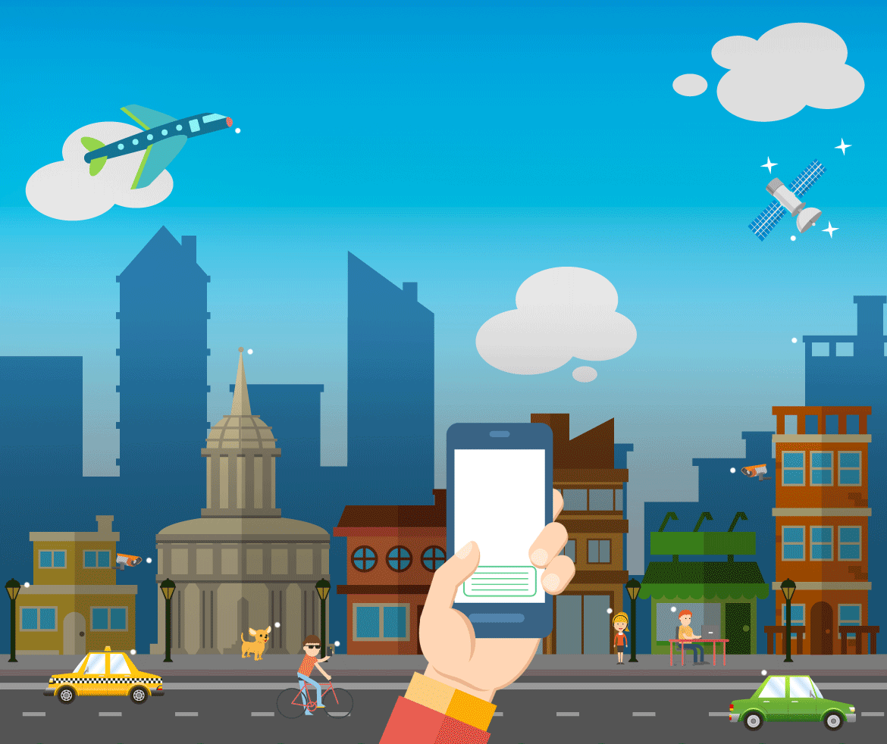
Why IoT is important
The internet of things helps people live and work smarter, as well as gain complete control over their lives.
IoT provides businesses with a real-time look into how their systems really work, delivering insights into everything from the performance of machines to supply chain and logistics operations.
IoT enables companies to automate processes and reduce labor costs. It also cuts down on waste and improves service delivery, making it less expensive to manufacture and deliver goods, as well as offering transparency into customer transactions.

Slide 11

HOW TO START AS A COMPUTER SCIENCE STUDENT
Know Your Network: The string connecting all your IoT devices is the internet. You don’t need to know the A-Z of the internet before you start. But knowing the basics and learning along the way is a must.
2. Sharpen Your Programming Language: In IoT, JavaScript and Python are becoming popular . However, the most important language for IoT projects remains to be C.
3. Machine learning and AI: IoT devices accumulate enormous amounts of data through sensors. Once your device gathers data , it need someone to make sense of that data.Here, Machine Learning and AI come to the rescue. Tesla self-driving car is one such example where IoT and AI come together to save the world.

Slide 12
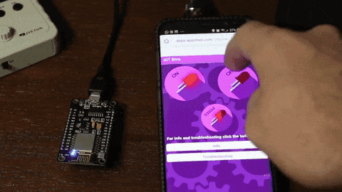
4. Keep Calm and Stay Secure: IoT connects you to a lot of devices. It also exchanges information from your smartphone to IoT enabled .Security should be considered in each phase of the project
5. Start Small: Don’t start trying to build a self-driving car. This is quite ambitious, but it will stress you out.
As “Hello world” is to programming, “Hello blinky” is to IoT. It is a simple project to make an LED blinking app and connect it to your IoT device. When you can make such small projects you can go bigger and better.
6. Keep Yourself Updated: IoT is changing every day with lightning speed. From one language to another, from one security measure to another, it’s vital to be updated about all current trends.

Slide 13
CONCLUSION
In conclusion, the Internet of Things is closer to being implemented than the average person would think. Most of the necessary technological advances needed for it have already been made, and some manufacturers and agencies have already begun implementing a small-scale version of it.
The main reasons why it has not truly been implemented is the impact it will have on the legal, ethical, security and social fields . But all these challenges can be overcome using the emerging technology itself.

Slide 14
REFERENCE:
https://www.guru99.com
https://internetofthingsagenda.techtarget.com/definition/Internet-of-Things-IoT
www.networkworld.com
www.edureka.com
www.zdnet.com
www.geeksforgeeks.org
www.paxtechnica.org

Slide 15
THANK YOU

